Slide 1
r1
r1
r2
r2
dist
dist
rSum = r1+r2
(a) No collision (dist>rSum)
(b) Collision (dist<rSum)
Figure 9-2

Slide 2









$$mFaceNormal[0]$$
$$mVertex[0]$$
$$mVertex[1]$$
$$mFaceNormal[3]$$
$$mFaceNormal[1]$$
$$mVertex[3]$$
$$mVertex[2]$$
$$mFaceNormal[2]$$
$$Figure 9−3$$

Slide 3
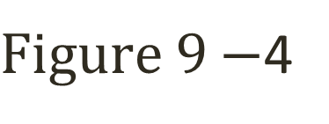
c1
Start
Normal
r1
Depth
End
End
Depth
Normal
Start
c2
$Figure 9−$4

Slide 4
c1
collisionInfo.mStart
mDepth = rSum – dist
dist
vFrom1to2
c2
Figure 9-6

